Slide 1

Project Title - Seasonal Agriculture Performance Analysis
Student Name – Pallab Bag
College Name- MCKV Institute Of Engineering
AICTE STU ID : STU6850e967dbfaf1750133095

Slide 2

PROBLEM STATEMENT
Agricultural activities are influenced by seasonal variations in environmental conditions, farming practices, resource availability and market conditions. As a result, agricultural performance may differ from one season to another. However, raw agricultural data does not clearly explain how agricultural performance changes across seasons or what patterns can be observed in different seasonal conditions. The problem is to analyze the given agricultural dataset and investigate seasonal differences in agricultural performance by identifying meaningful patterns, trends, relationships and variations within the available data.

Slide 3
Project Description
Seasonal Agriculture Performance Analysis is a data analytics project focused on understanding how agricultural performance varies across different seasons, regions, and farming conditions. The project involves exploring, cleaning, and analyzing agricultural data related to crop production, environmental conditions, resource utilization, and economic outcomes.
Through statistical analysis and data visualization, the project aims to identify seasonal trends, compare agricultural performance across different periods, discover relationships between environmental and farming factors, and highlight significant variations or unusual patterns. The insights obtained from the analysis can support evidence-based decision-making and better seasonal agricultural planning.

Slide 4

WHO ARE THE END USERS?
Farmers – Understand seasonal crop performance, resource usage, and productivity patterns.
Agricultural Departments & Government Agencies – Support data-driven agricultural planning and policy decisions.
Agricultural Analysts & Researchers – Study seasonal trends, environmental factors, and crop performance.
Agribusinesses & Cooperatives – Analyze production and economic trends to improve planning and resource allocation.
Resource Management Organizations – Understand seasonal requirements for resources such as water, fertilizers, and other inputs.

Slide 5

Technology Used
Python – Data analysis and processing
Jupyter Notebook – Development environment and documentation
Pandas – Data cleaning, manipulation, and analysis
NumPy – Numerical computations
Matplotlib – Data visualization
Seaborn – Statistical and comparative visualizations
CSV / Excel – Dataset storage and input format

Slide 6
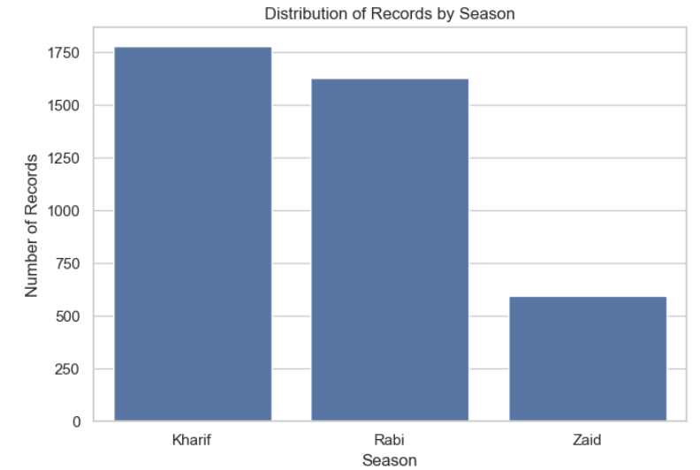
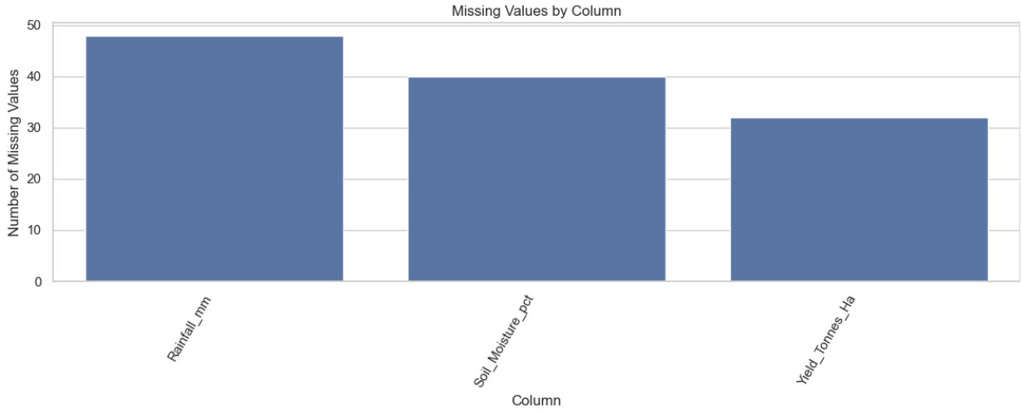
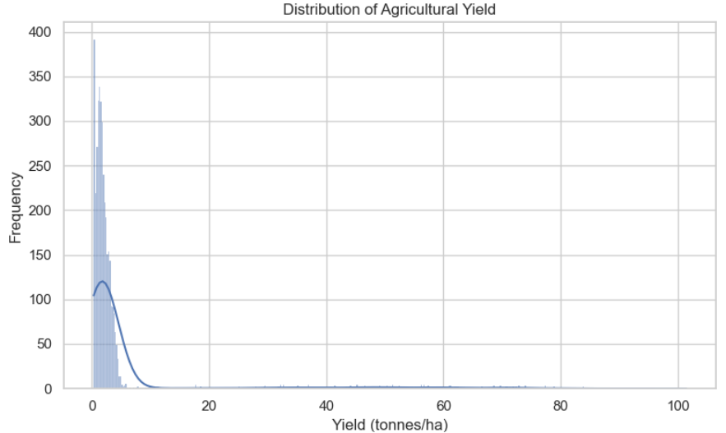
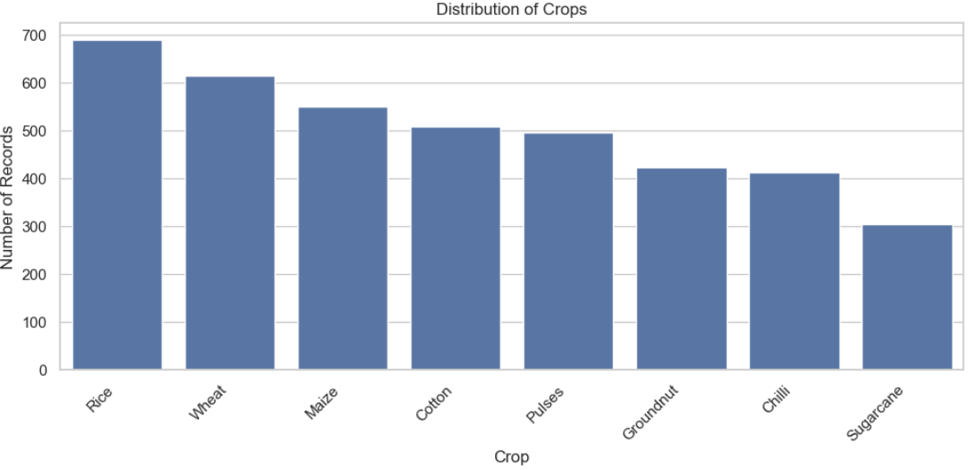
RESULTS

Slide 7
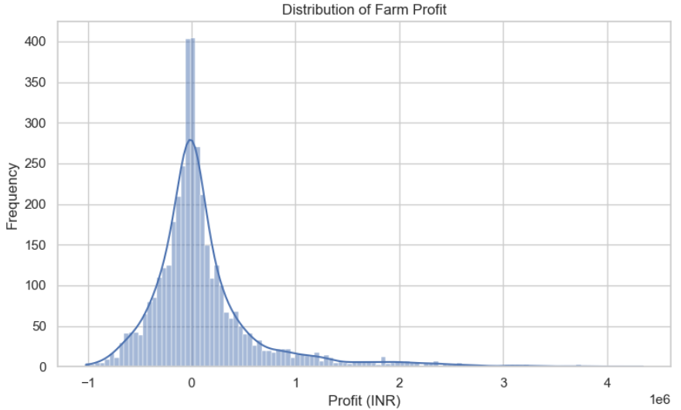
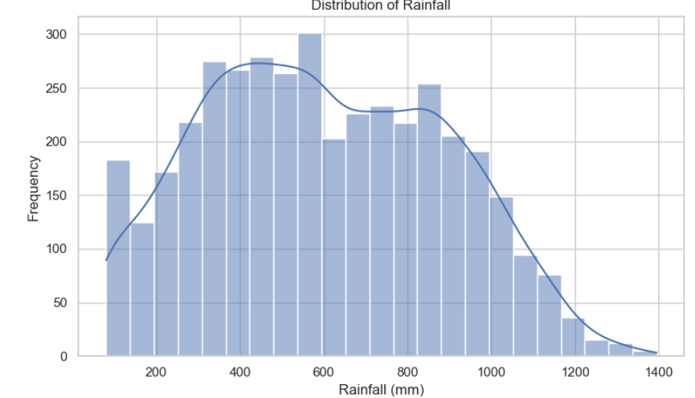
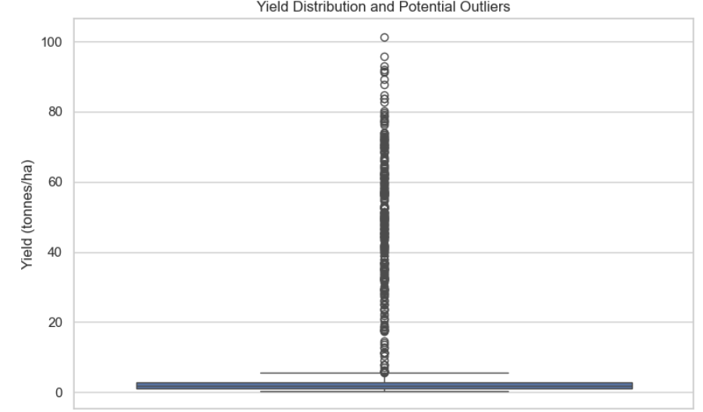
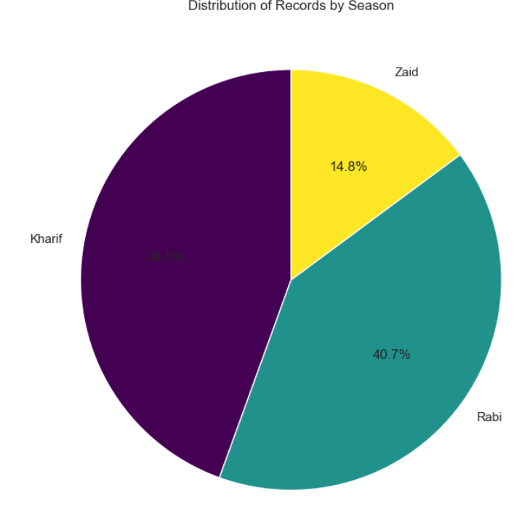
RESULTS

Slide 8
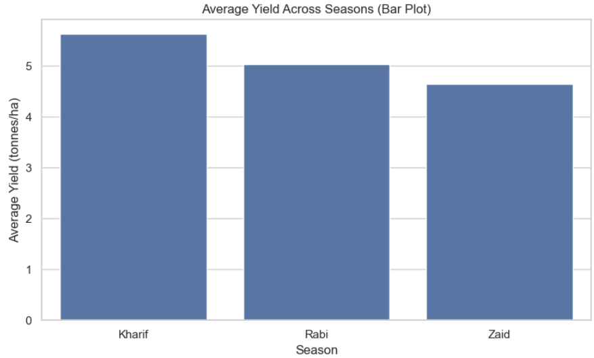
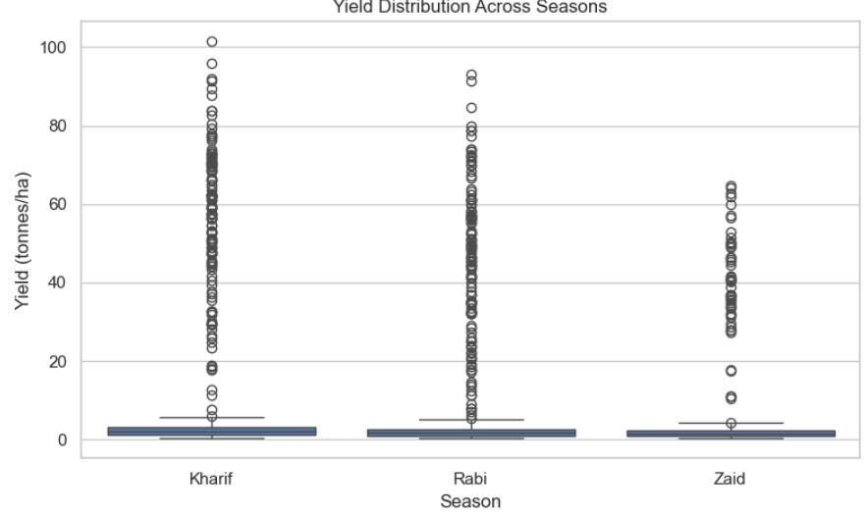
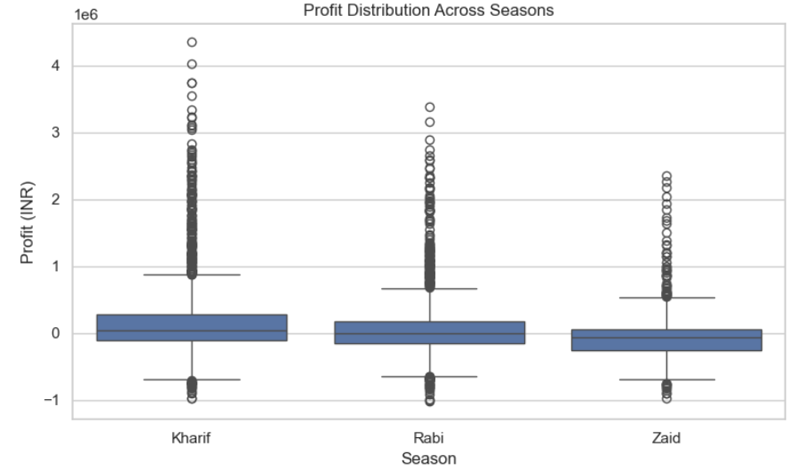
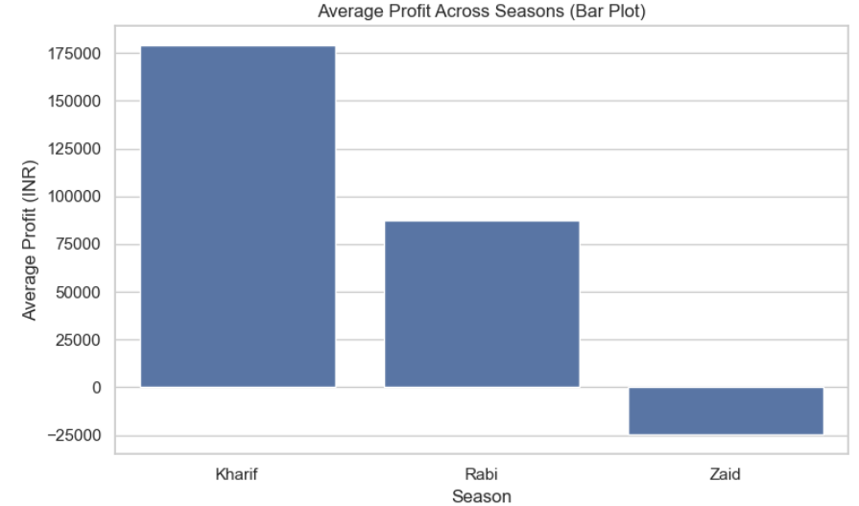
RESULTS

Slide 9
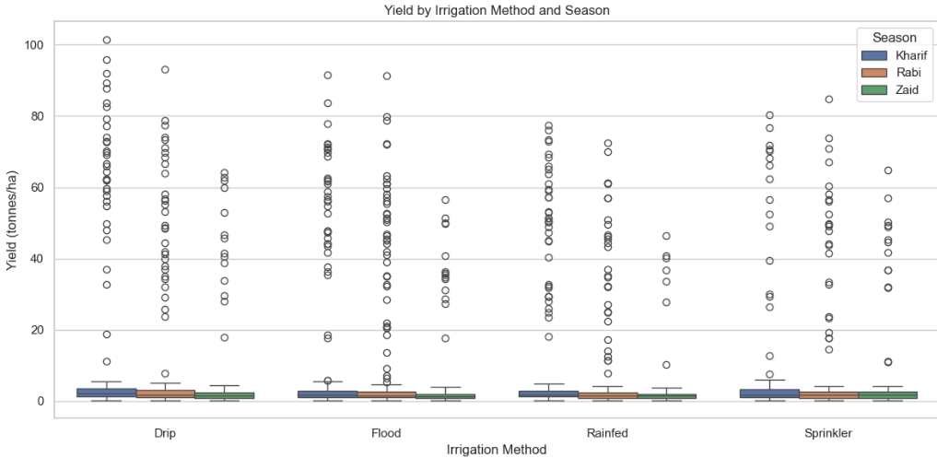
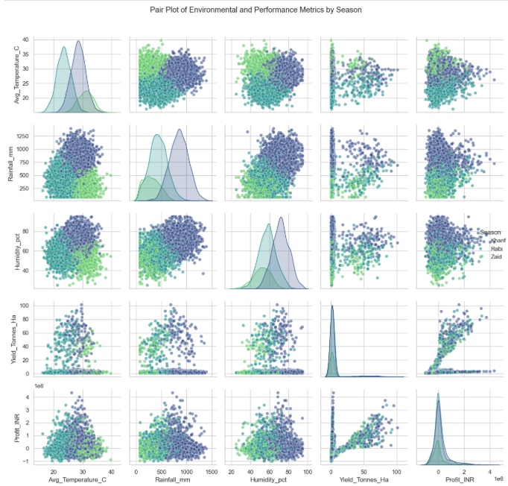
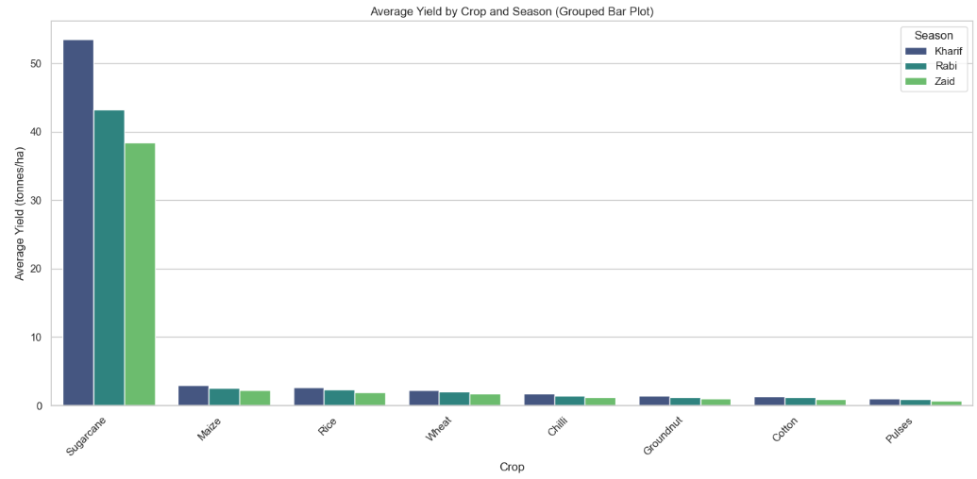
RESULTS

Slide 10
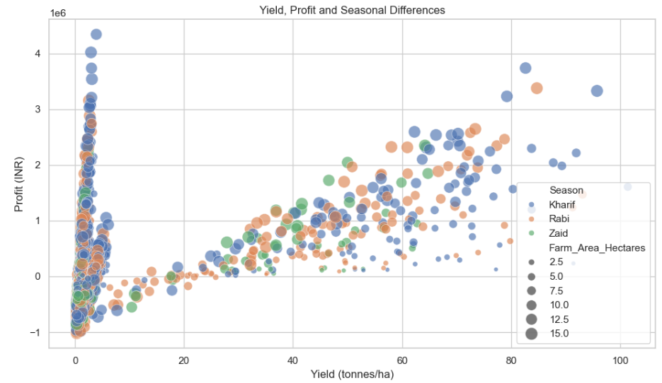
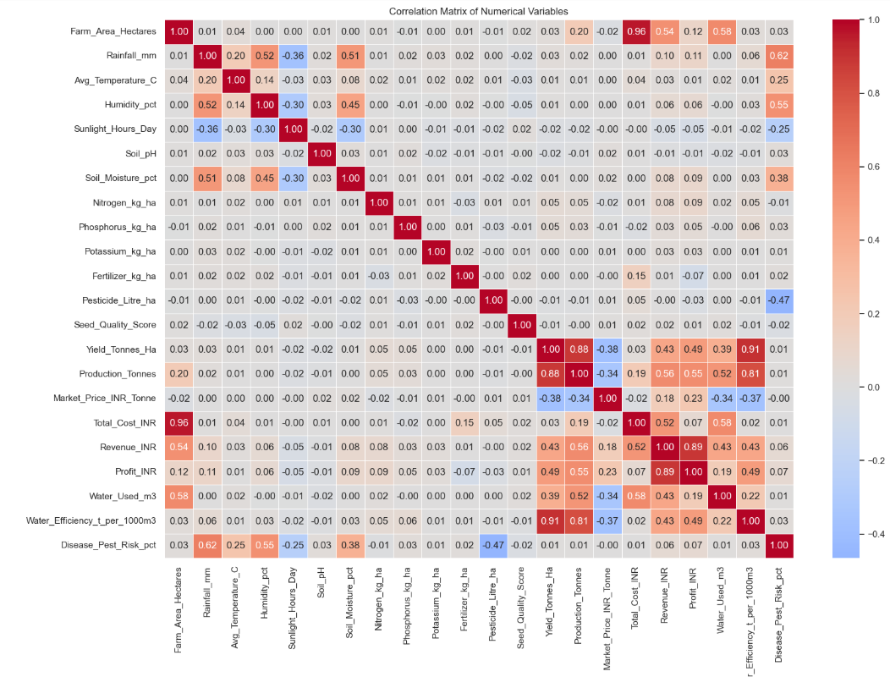
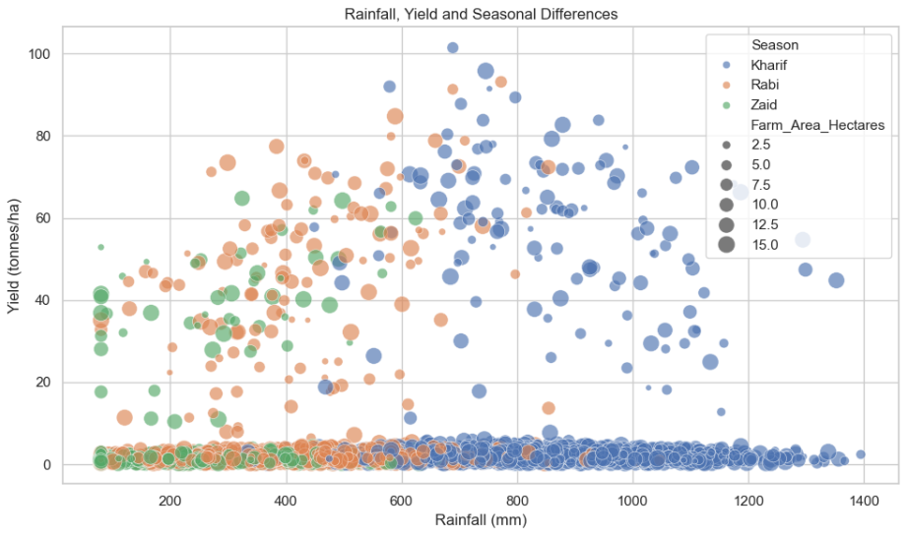
RESULTS

Slide 11
Future scope
Real-Time Analysis – Integrate real-time agricultural and environmental data for continuous monitoring.
Weather Integration – Incorporate weather and climate data to better understand seasonal impacts.
Predictive Analytics – Develop models to predict crop yield and agricultural performance for upcoming seasons.
Regional Analysis – Extend the analysis to identify region-specific agricultural trends and challenges.
Interactive Dashboard – Build a dashboard for farmers, researchers, and government departments to explore insights easily.
Better Resource Planning – Use insights to optimize water, fertilizer, and other agricultural resource usage.

Slide 12
GitHub Link
https://github.com/pallab-at-tech/Seasonal-Agriculture-Performance-Anal.git

Slide 13
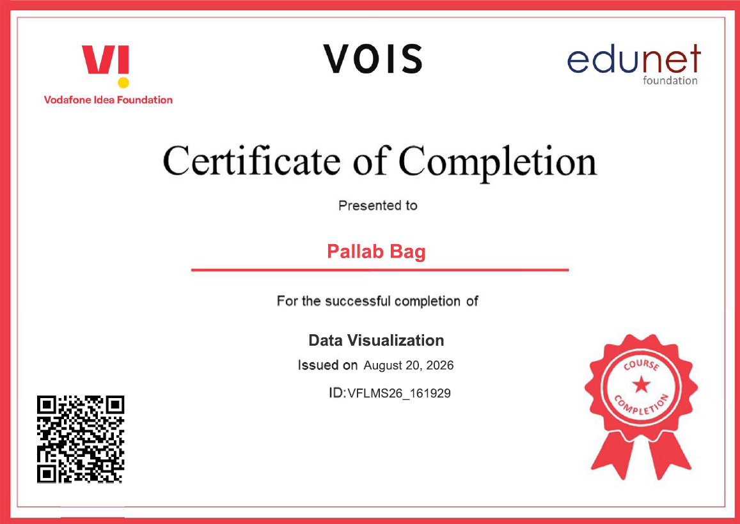
VOIS Course completion certificate -
Course name- Data Visualization

Slide 14
Thank you
.
.

